Slide 1
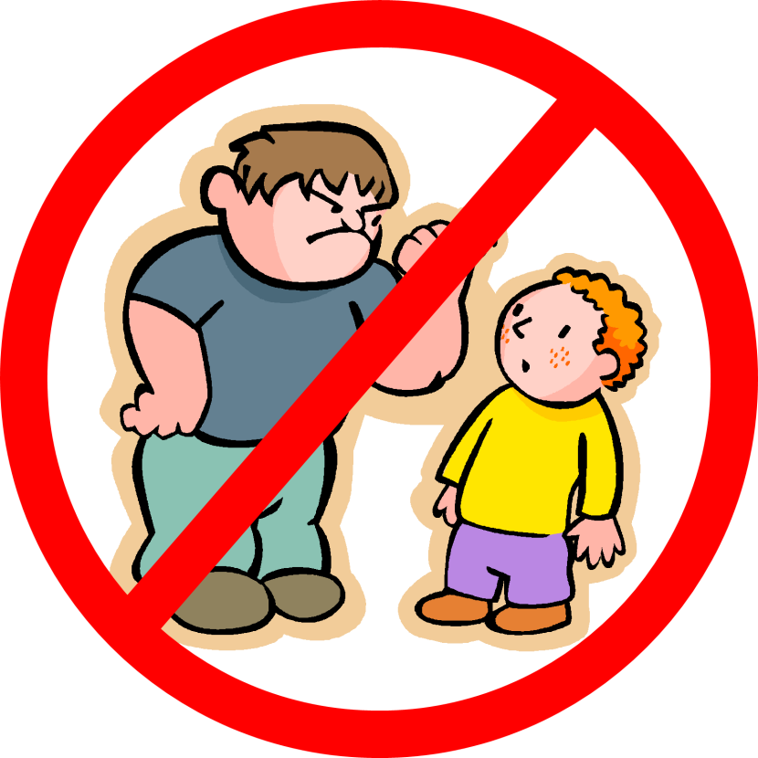
Anti - Bullying
An interactive scenario game for Anti-Bullying Week

Slide 2
Introduction
Hello and thank you for clicking on this game !
In this game we are going to present you with four scenarios, each has a different character and a different type of bullying. It is your job to guide each of these characters through the story and help them to overcome bullying.
Use the arrows to choose which option you prefer!
At the end of the four scenarios we’ll quiz you on how well you paid attention to the types of bullying we covered.
Click on the next slide to get started
Good luck!

Slide 3
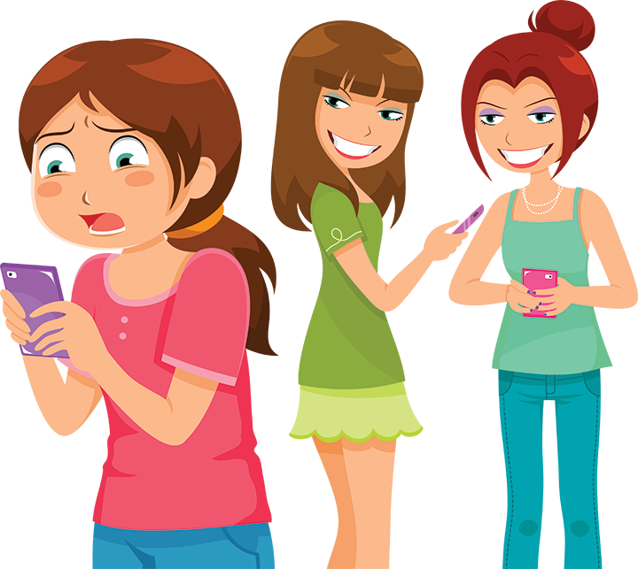
Scenario 1
Jane is a happy girl with a close knit group of friends. They sit together in classes at school and hang out on the weekend; this usually includes going to the park or doing something in their local city centre.
The past few days Jane has started to notice pictures showing up on social media, in these pictures her friends are hanging out together at the cinema. The day before Jane asked the group if they would want to see a movie, they all declined. Jane thinks her friends have purposely excluded her.
What do you think Jane should do?
Confront her friends
Ignore the pictures

Slide 4
The next day at school Jane directly confronts her friends, she asks why she wasn't invited to go the movies.
One of her friends, Margo, smiles and replies that they 'forgot to invite her'.
Throughout the rest of the day Jane notices that her friends seem to be making an effort to ignore her, they leave when Jane sits at their table at lunch time and walk home without her at the end of the day.
This makes Jane feel anxious and upset, especially when they begin to ignore her messages and phone calls.
Jane want's to talk to someone about what has happened and how she feels.
Who do you think Jane should talk to?
Her parents
Her teacher

Slide 5
Jane goes home that night and tells her parents what happened that day in school, she tells them how upset and alone she feels.
Her parents comfort her and decide to set up a meeting with her teachers. They also do some research and give Jane some resources which can provide her with support and advice on what to do if these kinds of situation occur again.
She feels better now, like a weight has been lifted off her chest; she is happy that she spoke up when she did.
Scenario 2

Slide 6
The next day Jane sets up a meeting with her teacher during lunch break.
She tells her teacher about everything that has happened over the past few days, from being excluded to being dismissed and isolated from her friends.
Her teacher comforts her and they begin to discuss options for Jane moving forward, these range from moving class to bringing in the girls’ parents. Her teacher gives her a list of recourses that she can use.
She does home that night, happy that she spoke to someone about her experience. She begins to read through the recourses that her teacher gave her; she feels less alone knowing that so many other children have gone through what she has.
Scenario 2

Slide 7
Jane ignores the pictures and goes about the next day as normal. However, throughout the day she notices that she is not being included in group discussions and that her friends seem to not want to sit with her in class. She begins to feel excluded and isolated.
During lunch break she contributes to a group conversation about afterschool clubs. At her contribution she notices some of her friends roll their eyes at her, one of the girls responds "No one cares what you think Jane".
This upsets Jane and she leaves to go to her next class. Her teacher, noticing that she is upset, comes over to her and asks her what is wrong?
What do you think Jane should say?
Tell her teacher what has been going on
Stay silent and say nothing

Slide 8
Jane looks down at her desk and shakes her head. “Nothing is wrong miss.” she murmurs. Her teacher clearly does not believe her but drops the subject.
When Jane’s friends arrive for class they sit at the table opposite Jane, they whisper to each other and occasionally look up at Jane to giggle. Jane tries to ignore them but becomes visibly upset.
Her teacher notices this and moves Jane to another table at the other end of the room, she asks Jane to stay behind after class. Jane relaxes, she plans to explain everything to her teacher but wishes she had said something earlier.
Scenario 2

Slide 9
Jane sets up a meeting with her teacher for the next day.
She tells her teacher about everything that has happened over the past few days, from being excluded to being dismissed and isolated from her friends.
Her teacher comforts her and they begin to discuss options for Jane moving forward, these range from moving class to bringing in the girls’ parents. Her teacher gives her a list of recourses that she can use.
She does home that night, happy that she spoke to someone about her experience. She begins to read through the recourses that her teacher gave her; she feels less alone knowing that so many other children have gone through what she has.
Scenario 2

Slide 10
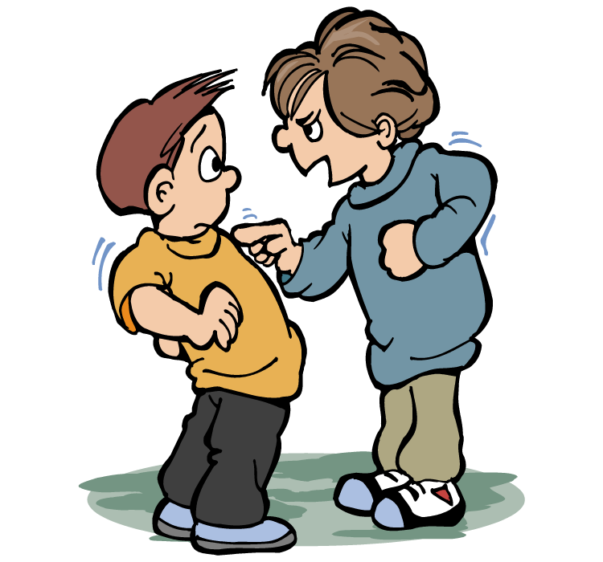
Scenario 2
On Wednesday afternoons Mathew plays football in the afterschool club run by his Comprehensive . He knows most of the boys from his classes and they all get on fairly well. As the competitive season hasn’t begun yet they are still playing friendlies against other schools. Today they lost a friendly by 2 goals, no one on the team seems that upset by the loss.
After the game Mathew realizes he left his phone in the locker room, as he goes to retrieve it he sees that one of the boys has their goalkeeper James pinned against the wall. He’s shouting in James’ face and blames him for deliberately throwing the game. Mathew notices that James is sporting a red mark around his eye that would surely develop into a black eye.
What do you think Mathew should do?
Intervene
Walk away

Slide 11
Mathew retrieves his phone quietly and quickly runs out of the locker room, he hears a bang come from behind him but does not turn back.
That evening he returns home and thinks about whether he did the right thing, he hopes James isn’t too badly hurt and decides to check up on him in school tomorrow morning.
The next day Mathew walks into class and see’s James sitting in the corner, his eye is dark purple and swollen shut. Mathew winces at how bad he looks.
Instead of sitting with his friends he decides to sit next to James who barely acknowledges him.
He comments that James should speak to a teacher about what happened. James replies that he doesn't want to ‘make things worse’
What do you think Mathew should do?
Respect James’ decision
Convince James to tell a teacher

Slide 12
Mathew and James arrange to meet with their teacher the following day.
The teacher can see the extend of James’ injuries which have not healed yet. James describes the incident which occurred in the locker room, Mathew validates his story and tells their teacher that he was also threatened.
The teacher comforts the boys and tell them they were very brave to come forward. She explains that none of what happened was either of their faults and arranges a meeting with their parents and the headteacher. For the rest of the day she offers for them to switch to another class to calm their anxiety.
Before they leave she gives them a list of recourses that they can use.
Mathew and James leave the teachers office feeling less scared, they are happy that they spoke up when they did.
Scenario 3

Slide 13
The next Wednesday James does not turn up to football practice leaving the team without a goal keeper. The boys are annoyed because they’re replacement goal keeper does not have that much experience. The same boy that hurt James the week before seems angry and comments to the other boys that when he sees James next he’ll ‘teach him a lesson’.
Not wanting James to get hurt again, Mathew approaches their coach after the game and explains what happened to James in the locker room the week before.
The coach takes this very seriously and organises a meeting between the boys, their parents and headteacher.
Mathew is happy he told someone before James could be hurt again.
Scenario 3

Slide 14
Mathew calls out to intervene.
The boy holding James to the wall drops him and storms towards the door, before leaving he stops next to Mathew and tells him that if he says anything to anyone about what he saw he would ‘come after’ Mathew next.
James thanks Mathew for intervening and asks him whether he plans on telling anyone.
James is scared but wants to tell his teacher about what has happened, Mathew is not sure.
What do you think Mathew should do.
Tell a teacher immediately
Agree with James and stay silent

Slide 15
Scenario 3
For her 14th birthday Katie’s parents give her the new phone she has been asking for. She’s ecstatic her old phone was a hand down from her sister Molly, it has a scratched screen and a broken camera. After setting up the wifi she opens the app store and fills her home screen with social media apps. She decides the first picture she wants on her phone is a selfie, which she then posts on Instagram with the caption ‘happy to finally have a good camera’. With that done she turns off her phone and continues opening her presents.
Throughout the day Katie gets many likes and comments on her selfie. The comments are mostly from friends complementing Katie; focusing on her makeup and how ‘pretty’ she is.
Towards the end of the day Katie notices that one of the girls in her class Sera has left a comment on her picture, ‘Thnx for ruining my feed with ur face’, it reads.
Katie is shocked and upset by this comment, she’s worried about other people seeing it and making fun of her.
What do you think Katie should do?
Delete her selfie
Respond to the comments

Slide 16
Katie deletes the post quickly, she feels upset and embarrassed by the comments. She is afraid that other people at school will have seen the comment. She decides to post more pictures, hoping that it will take the attention away from the one she deleted. The pictures she posts are of her friends and family rather than a selfie. She repeatedly reloads the page and waits for more likes and comments. Within moments Sera leaves more hateful comments on her new posts, this time Sera’s friends have joined in and also posted nasty comments on Katie’s posts.
The following day at school Katie hears murmuring from the other kids in her class, she knows that they must have seen the comments left on her pictures. Katie feels alone and needs advice. She has an older sister who knows more about social media than she does, but she could also speak to her teacher about what is going on.
What do you think Katie should do?
Speak to her sister
Speak to her teacher

Slide 17
Katie meets her sister Molly outside of the school gates at the end of the day to walk home, she asks if they can go the long way home so she can avoid the other kids in her class. Molly asks Katie if something Is wrong, but she declines to answer.
Realizing something is wrong Molly buys Katie an ice cream and asks whether she is enjoying her new phone.
Katie says that she is but is having a hard time on social media. Molly, knowing that her sister is being vague, comments that she has had a bad time with people commenting negative things on her pictures.
Katie perks up and asks how she managed it. Molly tells her that overtime she learned to ignore the comments and block the account, she offers to send Katie a list of articles on how to deal with online trolling.
Katie thanks Molly, she’s glad that she spoke to her sister about her problem.
Scenario 4

Slide 18
That afternoon Katie goes to see her personal tutor. Her personal tutor also serves a school councillor and knows a lot about bullying.
Katie is reluctant to tell her tutor what happened but with some gentle prompting she shows her tutor some screenshots of the comments that were left on her picture. Her tutor is sympathetic to her situation and explains that she did the right thing by coming forward.
Her tutor offers to bring Sera and her friends into her office, but Katie refuses; not wanting to make the situation worse.
Her tutor respects her decision and gives Katie a list of recourses that she can use to help combat online bullying.
Through these Katie decides to block Sera and her friends and makes sure to bring up any other incidents to her personal tutor.
Katie is happy, she feels safer online now.
Scenario 4

Slide 19
In a fit of anger Katie replies to the comment telling Sera to leave her alone and asking if she has ‘anything better to do’. Believing that she has solved the problem, Katie puts her phone down and goes to bed.
The next morning Katie wakes up to discover that even more people have left negative comments on her picture, specifically in reply to her dismissal of Sera.
Katie’s upset about the comments and doesn’t know what to do. She thinks perhaps a google search would give her some answers about how to remove the hurtful comment, but she also considers deleting the post and try to continue about her day.
What do you think Katie should do?
Delete the post
Use google to find some recourses

Slide 20
That day at school Katie hears murmuring from the other kids in her class, she knows that they must have seen the comments left on her picture before she deleted it. She feels particularly upset when she sees Sera laughing in her direction.
Katie feels alone and needs advice. She has an older sister who knows more about social media than she does, but she could also speak to her teacher about what is going on.
What do you think Katie should do?
Get some advice from her older sister
Speak to her teacher

Slide 21
Before school Katie does a google search asking what to do about negative comments online.
Through this search she comes across various videos and articles made by organisations and charities that combat online bullying. These recourses give her some great advice about how to deal with hateful comments on social media.
Using the advice of the recurses she found, Katie blocks Sera’s account from seeing her posts. She makes sure that the only people seeing her account are her friends and family members.
Katie leaves for school happier that day, while she is still upset about those comments; she feels safer and more secure online
Scenario 4

Slide 22
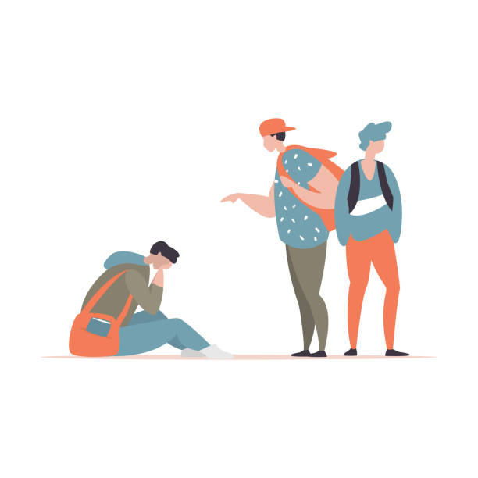
Scenario 4
It’s Louis’ first day in a new school, he recently moved to the city and doesn't know anyone. He’s nervous and shy about the idea of trying to make new friends.
Louis enjoys comic books and sci-fi movies, he keeps themed pins on his school backpack. He debates with taking them off for his first day at school, as he thinks they will help him look like a ‘wierdo’. After encouragement from his mum he keeps them on, hoping it will help him make friends with other people who have the same interests.
On his way to his first class a group of kids notice the pins on his backpack and begin to shout at Louis and call him names.
What do you think Louis should do?
Keep quiet and take the pins off later
Stand up for himself

Slide 23
Louis decides to stand up for himself, he asks the kids ‘what’s your problem’.
The kids start to laugh and sneer at him, deciding he doesn’t want to be subject to anymore name calling, he makes his way to his first class.
When he gets to class he asked by his teacher to introduce himself to the rest of the class, when returns to his desk he hears the kids from earlier in the hallway refer to him as ‘space boy’.
It makes Louis uncomfortable to be picked on for his interests.
On the phone before coming to school his personal tutor had called his house and told him that if he felt uncomfortable or had any issues he was welcome to come and see him.
Although, he figures he could always take the pins off and try to ignore his new nickname.
What do you think Louis should do?
Take the pins off
Arrange a meeting with his personal tutor

Slide 24
During the break between classes Louis goes to the boys toilets and rips the pins from his backpack, he hides them in his back pocket and returns to class.
He goes to his next class and decides to sit at the back of the class to not draw attention to himself. He notices a girl sitting 2 desks in front of him, she’s sitting by herself with her head down. He notices that on the jacket strung over her chair are badges from a sci-fi movie that he recognises.
When the kids from earlier enter the class they begin to giggle and laugh at the girl.
Louis wants to stand up for her but doesn’t want to draw more attention to himself, he figures he could just check up on her after class.
What do you think Louis should do?
Go and sit with her
Wait until after class

Slide 25
Louis picks up his things and goes to sit next to the girl that’s being picked on. As he approaches the lesson begins and the kids who were making fun of her turn around to face the teacher.
The girl looks surprised as Louis takes a seat next to her. He introduces himself and says that he likes her badges, he shows the pins that were in is back pocket.
The girl is enthusiastic about them, she replies that she loves sci-fi movies. She introduces herself, her name is Amelia.
Amelia tells him that this teasing is a regular occurrence and it has kept her from making friends, she says no one wants to be associated with a kid that’s getting picked on.
This frustrates Louis and he mentions that he plans on setting up an appointment with his personal tutor regarding the bullying, he invites her along and she agrees.
Louis is happy to have made a new friend and is happy he stepped in to help her.
QUIZ TIME!

Slide 26
After class Louis catches up with the girl before she can disappear into the hallway, he asks her is she is alright; he is worried being teased earlier has upset her.
She tells him that she is fine and that it is a regular occurrence that she has gotten used to. Louis, feeling guilty that she did not say anything to her in class, tells her that just because she is used to it; it does not make it ok.
She thanks him for his concern and introduces herself as Amelia, she mentions that she notices the pins he had on his bag this morning; she tells him she is a big fan of sci-fi too.
Happy to have found someone with a fellow interest, Louis invites Amelia to sit with him at lunch, he offers to go to a teacher to report the bullying that she is subject to. Amelia thanks him and agrees to see a teacher after lunch.
QUIZ TIME!

Slide 27
After lunch Louis goes to see his personal tutor, he tells her that he is having trouble fitting in and that kids are already making fun of him for his ‘weird’ hobbies and interests.
His tutor assures him that there is nothing wrong with his interest and tells him that he hasn’t done anything to deserve this kind of treatment.
His tutor offers to speak with his teachers to make sure he doesn’t sit near the kids that were picking on him earlier.
As they discuss various options for Louis, his teacher gives him a list of online recourses that he can use that will have some advice on how to deal with bullying at school.
Louis leaves the office happy that he spoke up when he did.
QUIZ TIME!

Slide 28
QUIZ TIME!!

Slide 29
Question 1 – what type of bullying was shown in scenario 1?
Social bullying
Verbal bullying
Cyber bullying
Physical bullying

Slide 30
WRONG ANSWER! Better luck next time The answer was social bullying
NEXT QUESTION

Slide 31
www.bullying.co.uk
RIGHT ANSWER!
What is social bullying?
This sort of bullying is often harder to recognise and is often carried out behind the back of the person who is being bullied. It includes:
Lying, fake rumours and spreading gossip
Encouraging others to turn against someone
Leaving someone out constantly and encouraging others to do the same
Socially excluding someone online, cyberbullying, negative comments on posts and images
Damaging someone's social reputation or social acceptance
Using humiliating nicknames and continuing when asked to stop
It isn’t easy for someone going through this to accept when the line crossed from being a prank or banter to persistent bullying. By the time you realise it is bullying, it may feel harder to seek support.

Slide 32
Question 2 - What kind of bullying was shown in scenario 2?
Social bullying
Verbal bullying
Cyber bullying
Physical bullying

Slide 33
WRONG ANSWER! Better luck next time The answer was physical bullying
NEXT QUESTION

Slide 34
RIGHT ANSWER!
thebullyshield.com
The definition of physical bullying is:
"When one repeatedly uses physical aggression, intimidation and assault against another person"
This can include actions such as: hitting, kicking, punching or tripping.
The key thing is that regardless of the type of bullying, the actions are repeated.

Slide 35
Question 3 - What kind of bullying was shown in scenario 3?
Social bullying
Verbal bullying
Cyber bullying
Physical bullying

Slide 36
WRONG ANSWER! Better luck next time The answer was: cyberbullying
NEXT QUESTION

Slide 37
RIGHT ANSWER!
www.bullying.co.uk
What Is Cyberbullying
Cyber bullying is any form of bullying which takes place online or through smartphones and tablets. Social networking sites, messaging apps, gaming sites and chat rooms such as Facebook, XBox Live, Instagram, YouTube, Snapchat and other chat rooms can be great fun and a positive experience. But what do you do when things go wrong?

Slide 38
Question 4 - What kind of bullying was shown in scenario 4?
Social bullying
Verbal bullying
Cyber bullying
Physical bullying

Slide 39
WRONG ANSWER! Better luck next time The answer was: Verbal bullying
MOVE ON

Slide 40
RIGHT ANSWER!
www.bullying.co.uk
Is it bullying or banter?
It can be confusing for someone to try and work out whether the name calling is banter or bullying. A young person going through something like this might feel intimidated or feel under pressure not to make a fuss because others are saying it is just a joke. If it is a one off incident then it may be that it is banter. However, if the name calling becomes persistent and regular, then this is bullying. It is equally about how you feel too, if it makes you uncomfortable and you have told them to stop but they are still name calling, then this is what we call verbal bullying. The verbal bullying can be anything about weight, appearance, racist, sexual or homophobic bullying. Name calling has been around for what may seem forever but for someone who is on the receiving end of this, it can often have devastating consequences.

Slide 41
THANKS FOR PLAYING
We hope you enjoyed this interactive experience and learned a thing or too about bullying along the way!
In addition to this PowerPoint we have curated a list of online recourses that can be found alongside this PowerPoint!
If you or anyone you know is experiencing bullying similar to the children in these scenarios remember to speak to somebody and not to suffer alone. Your all awesome!
Thanks again
- The Inspire Team

