Slide 1
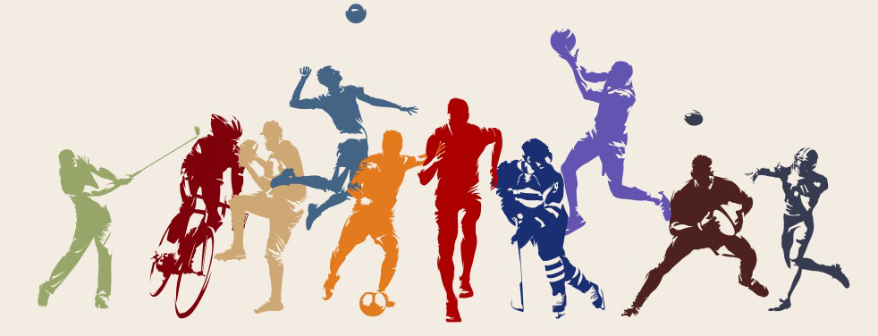
Sports Shuffle

Slide 2
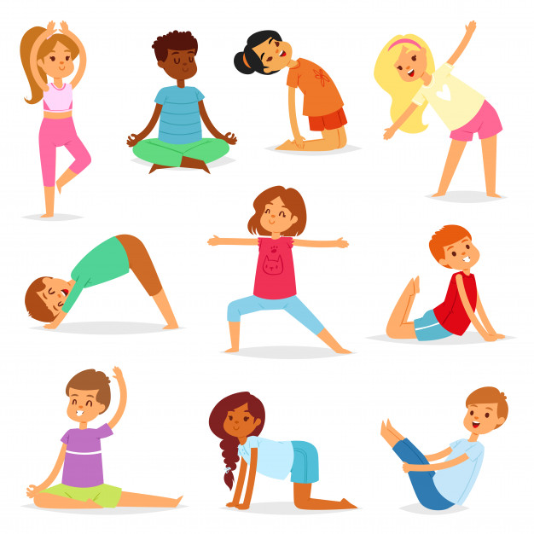
How the game works:
Click to shuffle the slides on the powerpoint and then do the exercise that comes up.
The exercises may differ from something simple to something more out there! Enjoy!
PS - don’t forget to stretch before and after!

Slide 3
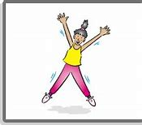
Do five star jumps!

Slide 4
Make up a random ten second dance routine and then show your friends and family!

Slide 5
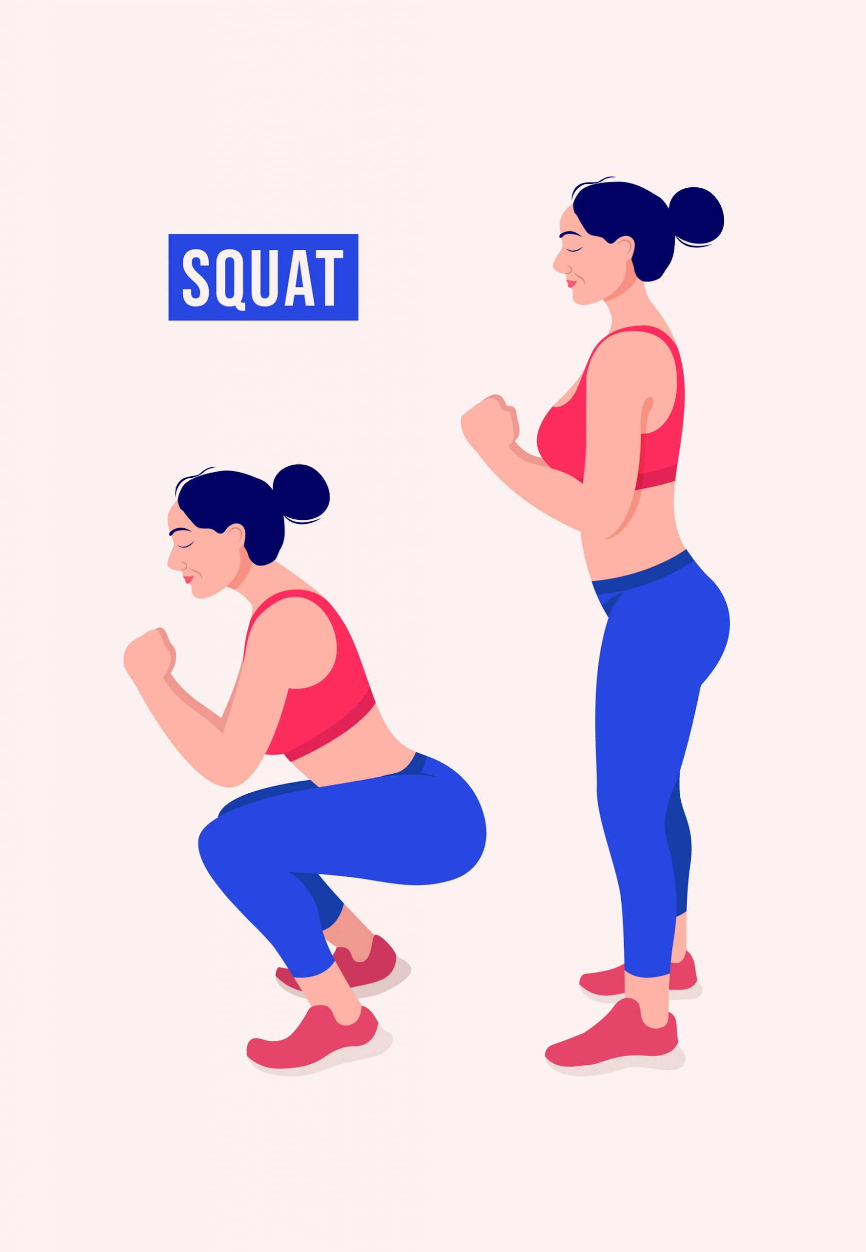
Do 5 squats!

Slide 6
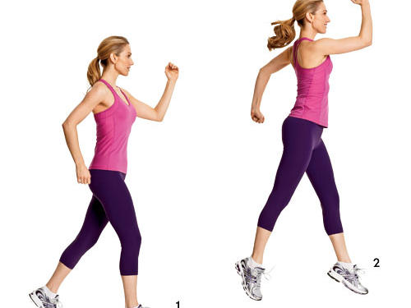
How many scissor jumps can you do in 10 seconds?

Slide 7
How high can you jump? Try it 3 times

Slide 8
Do the warrior pose for 1 minute

Slide 9
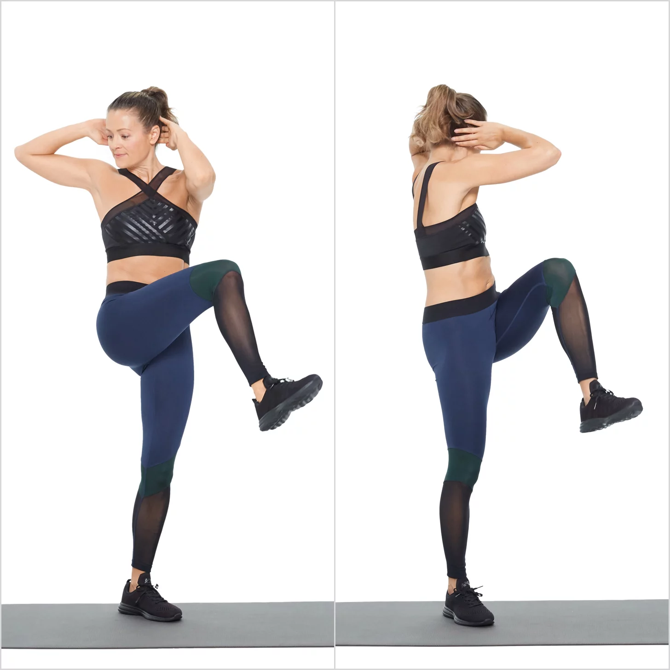
How many standing crunches can you do in 30 seconds?

Slide 10
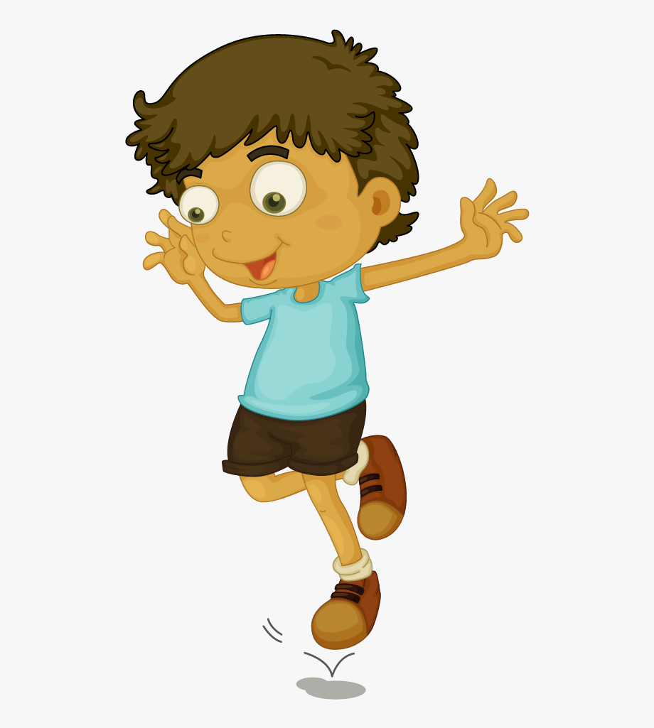
Hop on the spot 5 times!

Slide 11
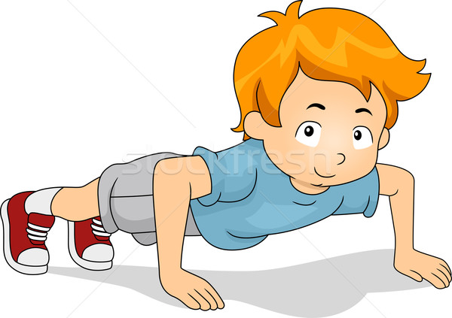
Do 5 press ups!

Slide 12
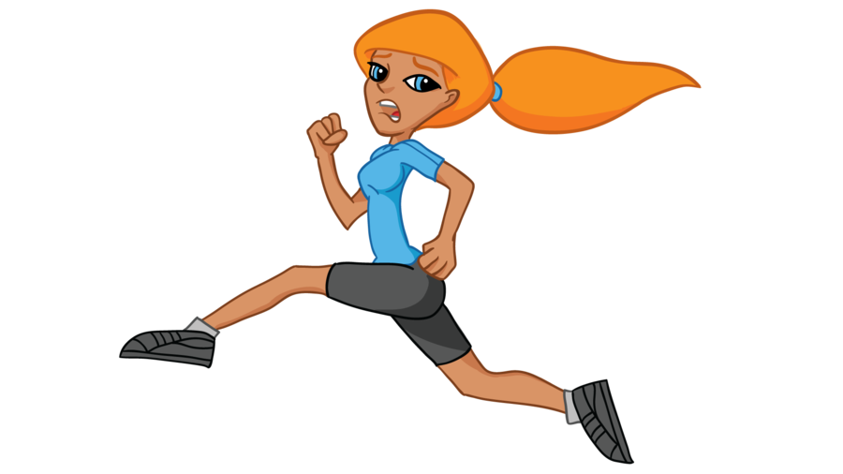
Run on the spot for ten seconds!

Slide 13
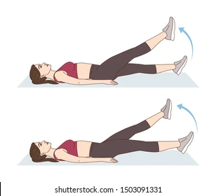
How many butterfly kicks can you do in 30 seconds?

Slide 14
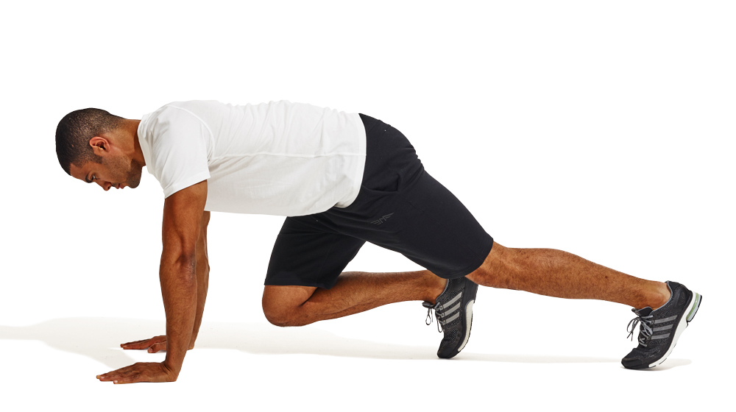
How many mountain climbers can you do in 30 seconds?

Slide 15
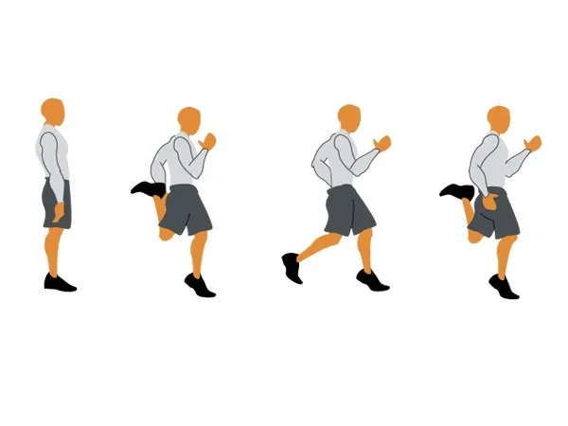
Do 5 leg kickbacks!

Slide 16
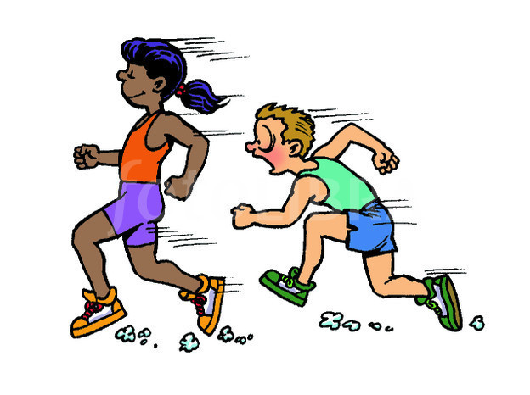
If you’re with a friend or family member, then have a quick race!

Slide 17
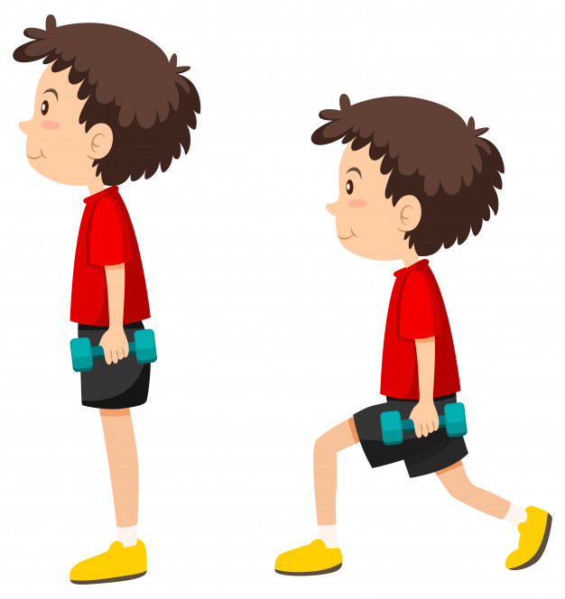
Do 5 lunges!

Slide 18
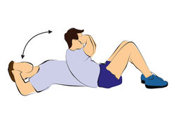
Do 5 sit ups!
If you’re with a friend or family member, then you can do this together. Lie opposite of each other and high five each other when you both sit up!

Slide 19
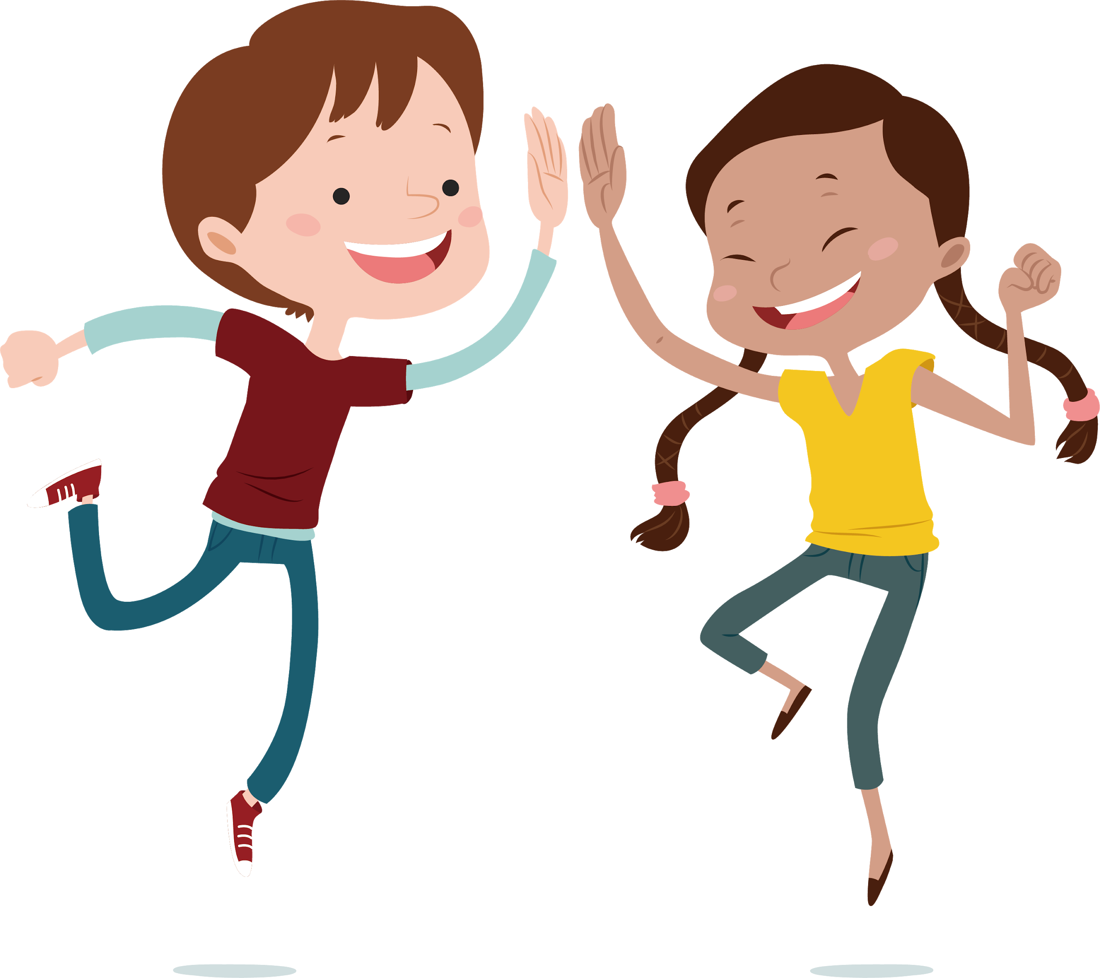
Jump on the spot for ten seconds whilst clapping!

Slide 20
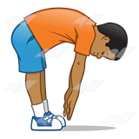
Touch your toes for ten seconds!
If you can’t touch your toes then see how far you can reach.

Slide 21
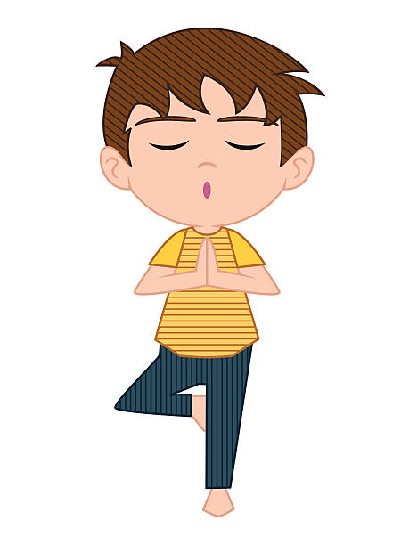
Do the tree pose for ten seconds!
This is where you stand on one leg, whilst bending the other leg and lifting it slightly. Then bring your hands together.

Slide 22
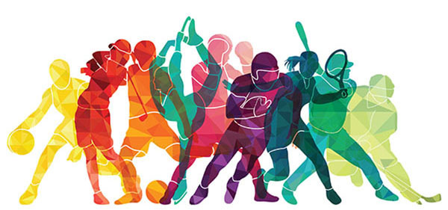
Are you tired yet?
If yes, have some water and rest
If not, give it another round!

